Slide 1
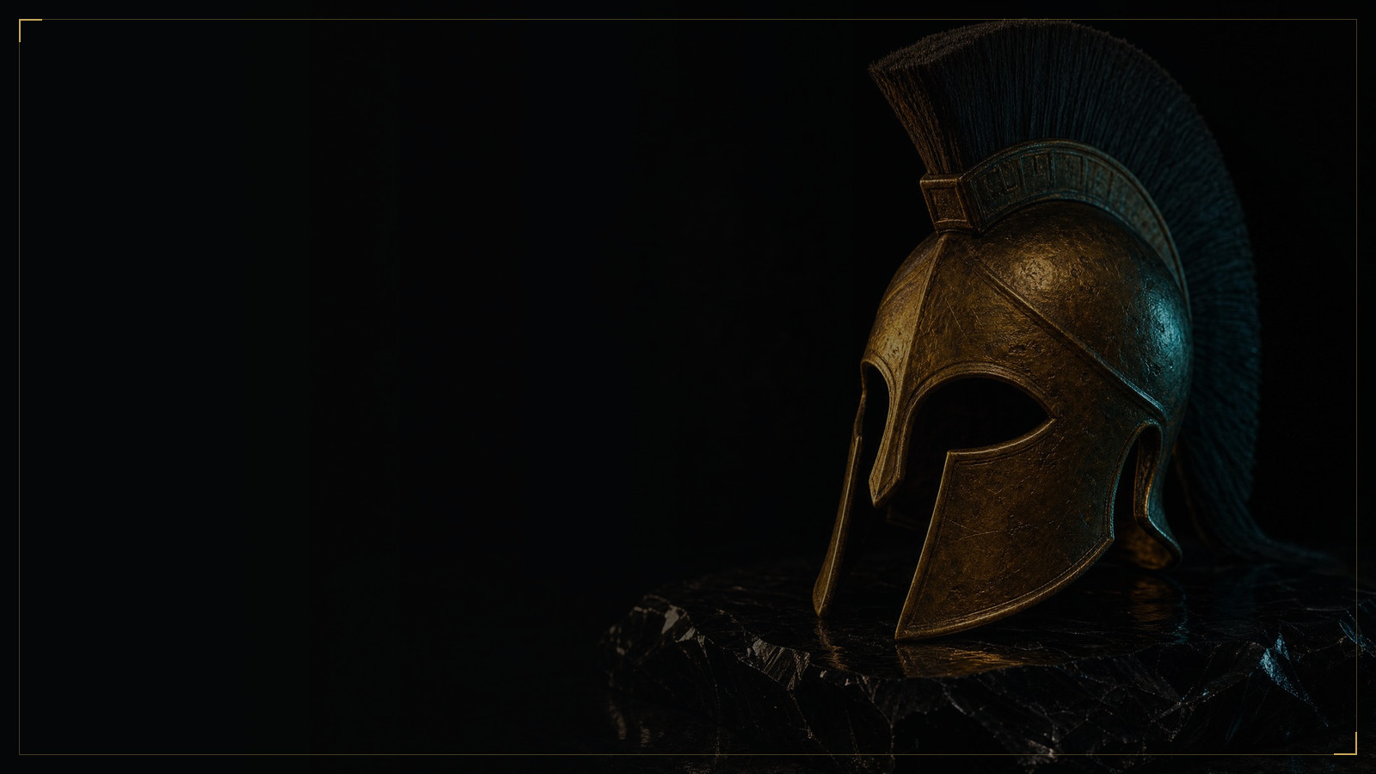


Spartan OS
ANUBIS
PROMOTER DECK · SEPTEMBER 2026
Spartan OS
on Anubis Chain
Built by the foundation that built Origin. Running on a chain they own. Ninety days in, paying every twelve hours.
ANUBIS LABS · FIRST ECOSYSTEM PROJECT · FOR LEADERS AND PROMOTERS
MMXXVI
Notes:
One line before the first slide: 'I want to show you three things tonight. Who built this. What the chain already does. And exactly what it pays, per day.' Then move.

Slide 2

Spartan OS
ANUBIS
01 · THE BUILDERS
The next chapter of a story you may already know.
Anubis Foundation: two years, five continents, twenty countries, more than a hundred projects. Three of them shaped everything that follows.
→
→
→
→
01
02
03
04
05
Capital
Origin
WebKey · Melos
Anubis Chain
Spartan OS
Anubis Foundation invests in Web3, DePIN and infrastructure
DeFi 3.0 on LGNS. Staking, bonds, protocol-owned liquidity, a global community
How users enter Web3 and what they do there: identity, gateway, entertainment
Their own Layer 1. Mainnet April 2026
The first application built to bring people onto it
PROOF
PROOF
PROOF
PROOF
PROOF
Five continents · twenty countries
2.5M holders at the peak
16M users, as stated
100M+ transactions
Live since 16 June 2026
WHY IT MATTERS TO YOU
SAME TEAM, SAME CODE
Most projects start from nothing: no users, no assets, no track record. This one starts with millions of holders who already know the foundation's name, and a chain the foundation controls.
Spartan OS runs 137 smart contracts on the codebase that ran Origin and Awake. The CertiK audit has been submitted. The people, the code and the chain are the same three names.
Foundation footprint as published at anubi.pro. Origin partnership announced by Anubis Foundation on 8 July 2024.
02 / 13
Notes:
Do not rush this slide. Leaders join people, not products. Say the names slowly: Origin. WebKey. Melos. Anubis Chain. Then: 'Same team. Same code. New chain.'

Slide 3

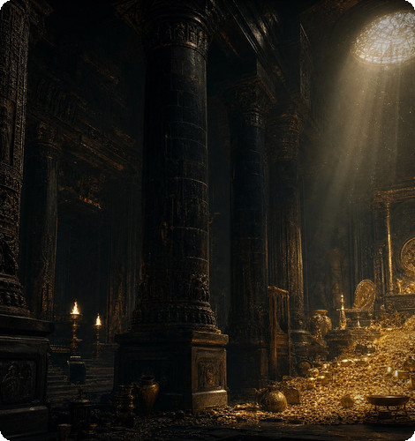
Spartan OS
02 · WHAT ORIGIN PROVED
They have done this before, at scale.
A historical market snapshot of the Origin ecosystem on AVE. Not today's prices. Proof that this foundation can build a market of millions and keep it alive.
2.5M
$1.4B
Holders of LGNS at the snapshot
Circulating market cap, LGNS
$200M
91,000
Liquidity pool, LGNS
Transactions in one day
$2.1B
$55M
Market cap of gLGNS, the second Origin asset
Still in the Origin pool on Polygon today, two years on
Historical AVE snapshot as supplied by Anubis Foundation, verifiable at ave.ai. Past figures, not current prices, liquidity or treasury. Origin pool today as stated in the 14 September 2026 briefing.
03 / 13
Notes:
The point is the last number. Two years later the pool is still there and people can still sell. 'Every other project of that generation is gone. This one is not.' Let it sit.

Slide 4
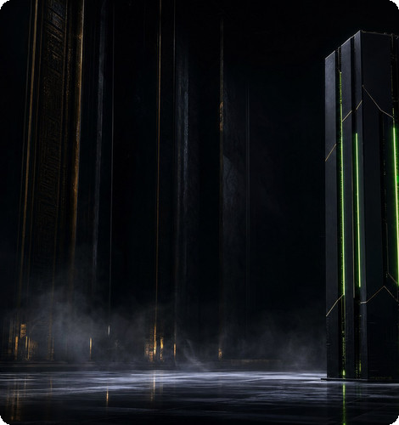
ANUBIS
03 · THEN THEY BUILT THE RAILS
Most projects rent a chain. This one owns it.
Anubis Chain went live in April 2026. Fees are paid in gasDAI, pegged to the dollar. Everything below is on the public explorer at browser.anubispace.org.
100M+
18M+
Cumulative transactions
Addresses
16K+
1.9K+
Smart contracts deployed
Tokens on the chain
~1 s
gasDAI
Average block time
Fees pegged to the dollar, the same every day
Network figures as published by Anubis Chain (periodic data report, September 2026). Indexed by The Graph, explorer by Blockscout, cross-chain via LayerZero, Stargate, Anubis Bridge and GaleBridge.
04 / 13
Notes:
'When a project runs on someone else's chain, the gas, the rules and the future belong to someone else.' Then the numbers. Then: 'You can check every one of them yourself tonight.'

Slide 5
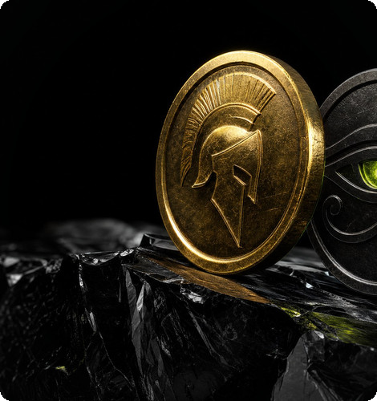
Spartan OS
04 · SPARTAN OS, NINETY DAYS IN
Two tokens. One live game. Numbers, not promises.
RM is the token you earn and use. GD is the governance token, 390,000 fixed. TempleRaid, with GoPlay, went live on 6 September. The dashboard on 14 September 2026 read:
$29M
500,000
USDT in the RM liquidity pool
RM holders
$18.85 → $30+
$40 → $16,000
RM price, launch on 16 June to 14 September
GD price, 4 May to 14 September
68%
$10M
of RM supply staked on-chain
Treasury in USDT
As stated by Spartan OS on 14 September 2026. RM supply 6.1 million. 137 smart contracts, same codebase as Origin. CertiK audit submitted. Verify on the explorer, the DEX and the dApp.
05 / 13
Notes:
Say '68% staked' twice. It means two out of three tokens are locked and earning, not waiting to be sold. That is the number a sceptic cannot argue with.

Slide 6
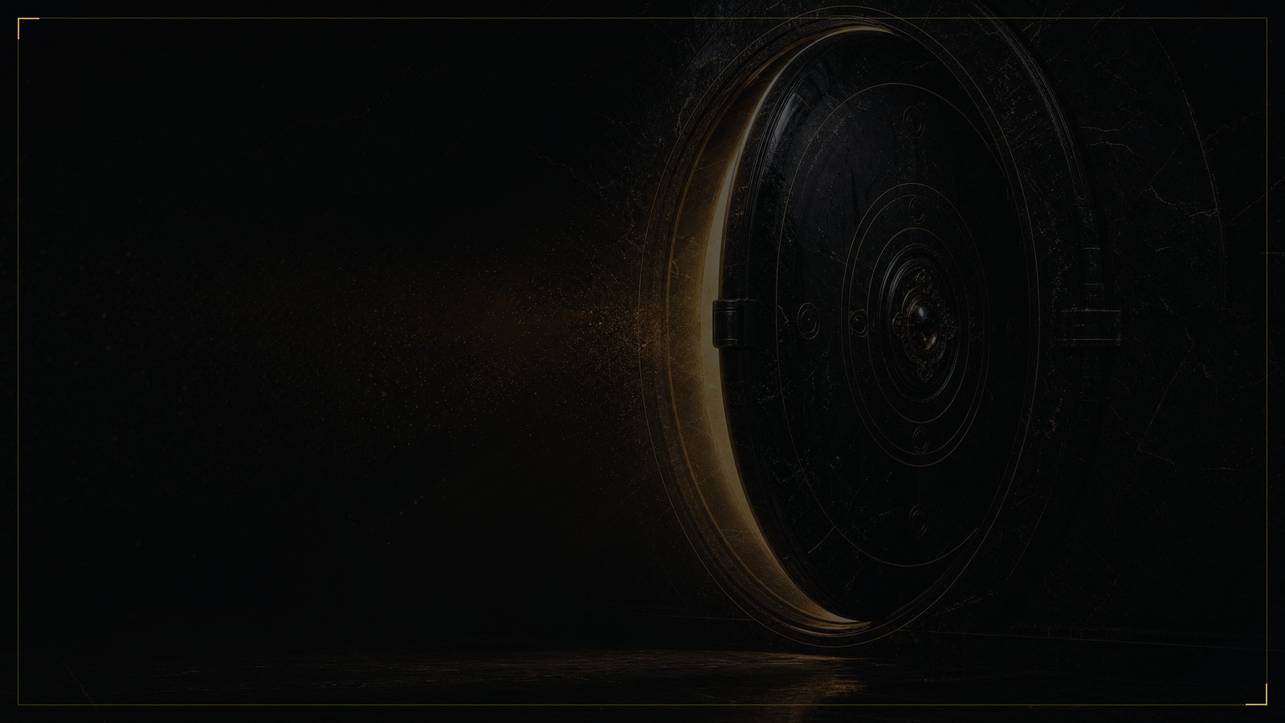





Spartan OS
05 · HOW YOU EARN
Five streams. All paid every twelve hours.
Four of them open from $1. Every RM you earn passes through the same turbine before it reaches your wallet.
STREAM ONE
STREAM TWO
STREAM THREE
STREAM FOUR
STREAM FIVE
Flexible staking
Long-term staking
Burning bond
Level income
Rank reward
0.6% A DAY
1.1 – 1.3% A DAY
1.5% A DAY, NET
8 · 4 · 2% OF DOWNLINE ROI
$15 – $1,200+ A DAY
0.3% every twelve hours on your RM, compounding by itself. In from $1, out whenever you like. About 20% a month if you leave it alone.
180, 360 or 540 days, from $1. Principal back in daily portions from day one, interest on top, extra rewards on top of that.
From $500. Releases 250% of the order, 150% net. Adds 20% energy and a 3% GD airdrop. Unlimited volume. No compounding.
Of the ROI your first three levels earn, paid to you every twelve hours. This is the one stream that uses energy.
V1 to V12 from the DAO pool, paid daily. The larger leg qualifies the rank, the smaller pays the reward. V1 from about $15 to $25 a day; every rank's range is on 09.
ENTRY
ENTRY
ENTRY
PAID
V1 NEEDS
From $1
From $1
From $500
Every twelve hours
$500 · 3 qualified directs · $10,000 per leg
LOCK
LOCK
CAP
NEEDS
RANKS
None
180, 360 or 540 days
2.5× · no maximum order
Energy to withdraw
V1 to V12
Rates as stated by Spartan OS on 7 and 14 September 2026. Rates float. Liquidity bonds pay in a lower entry price rather than a separate daily rate; see 08. Not a promise of return.
06 / 13
Notes:
Read the five numbers across the top, left to right, without commentary. Then: 'Every one of these lands every twelve hours.' Ask the room which stream is theirs. Move on before anyone answers.

Slide 7
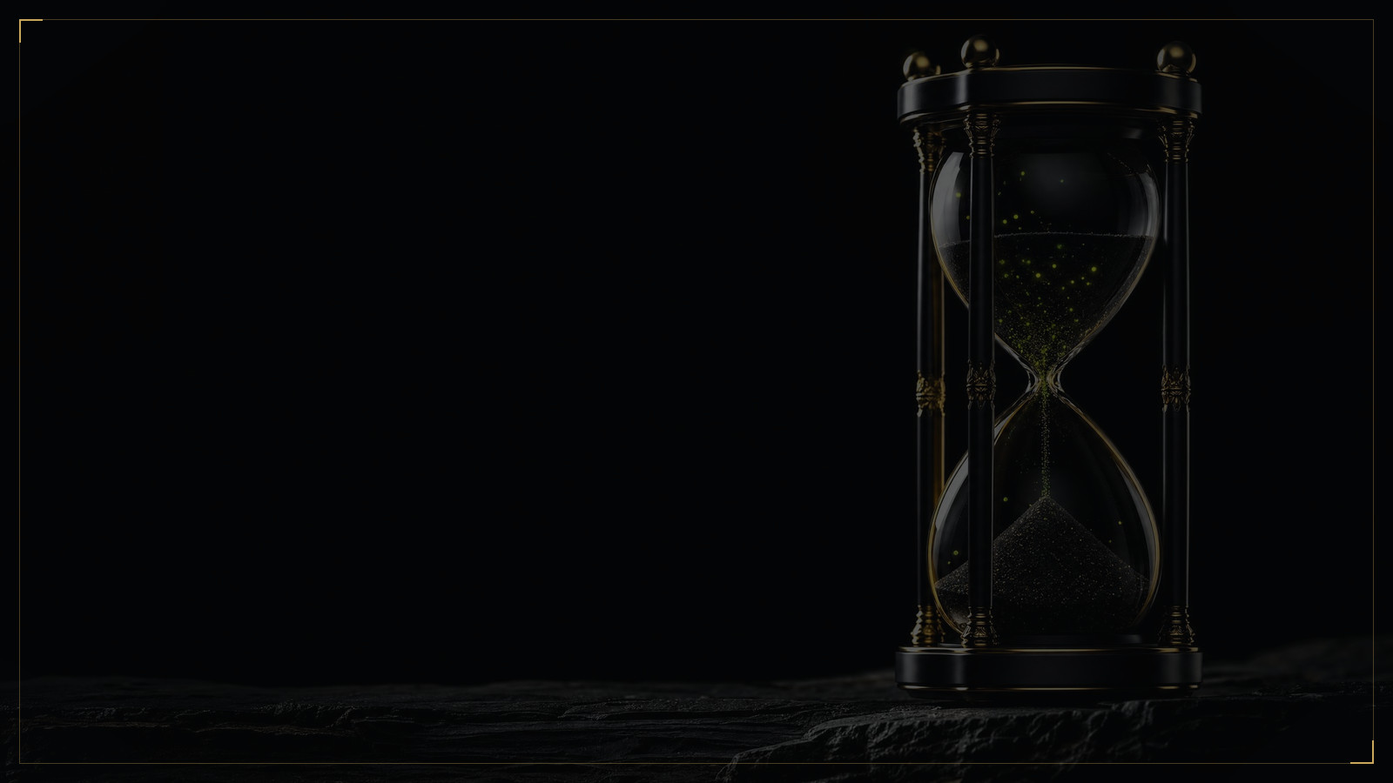
Spartan OS
06 · STAKING, IN ONE TABLE
Paid every twelve hours. Capped in dollars.
Principal comes back daily from day one. The cap is set in USDT the moment you enter. Rates float with the platform; the cap does not.
POSITION | DAILY RATE, AS STATED | ON $1,000, A DAY | ON $1,000, A MONTH | CAP ON TOTAL PAYOUT | PRINCIPAL
Flexible · from $1 · no lock | 0.3% per 12 h · 0.6% a day | $6 | about $180 · $200 compounding | None | Withdraw any time
180 days · from $1 | 1.1% a day | $11 | about $330 | 4× entry value | Released daily
360 days · from $1 | 1.2% a day | $12 | about $360 | 4.5× entry value | Released daily
540 days · from $1 | 1.3% a day | $13 | about $390 | 5× entry value | Released daily
WHAT NO ONE ELSE DOES
WHAT THE CAP MEANS
EXTRA REWARDS
Other Olympus-style systems hold your principal until the term ends. Here it comes back in daily portions from day one, alongside interest and extra rewards.
$1,000 in at 540 days can pay out at most $5,000 of RM value, all sources combined. Then the position is complete and you open a new one. That ceiling is what makes the rate believable.
Long-term positions only. Funded by 35% of the extra sell tax and claimable every twelve hours. They do not compound, so claim them daily.
Rates as stated by Spartan OS on 7 September 2026 (on 14 September: over 1.0%, 1.1% and 1.2%). Rates float; the cap is fixed in USDT at entry. Not a promise of return.
07 / 13
Notes:
Lead with the cap. 'A rate without a ceiling is a story. A rate with a ceiling is a contract.' Then run the middle two columns with your finger: six, eleven, twelve, thirteen dollars a day on a thousand.

Slide 8
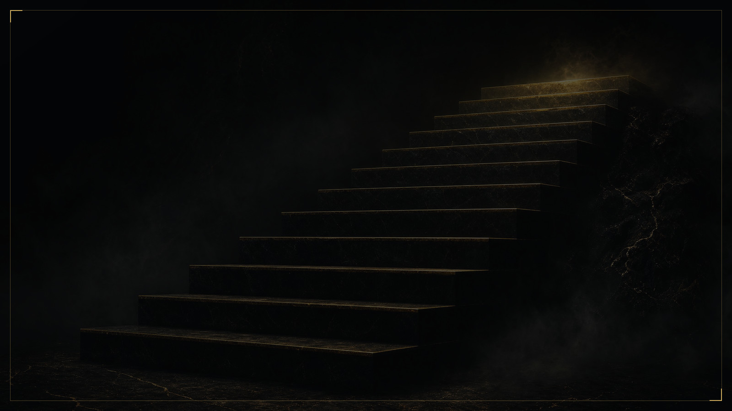
Spartan OS
07 · WHAT $1,000 PAYS
Same $1,000. Five daily numbers.
Simple daily rate as stated, on a $1,000 position, before team income and rank rewards. Compounding not included.
PER DAY, ON $1,000
$15
ON $10,000
$60, $110, $120, $130 or $150 a day. Between $1,800 and $4,500 a month, before a single team member.
$13
$12
$11
PER MONTH, ON $1,000
$6
About $180 flexible ($200 compounding), $330 at 180 days, $360 at 360, $390 at 540, $450 on a burning bond.
NO CAP
CAP 4×
CAP 4.5×
CAP 5×
CAP 2.5×
WHERE THE CEILING SITS
Flexible has no cap and no lock. At the stated rates the 360 and 540-day positions reach their ceiling in about ten months, the burning bond in about three. Then you open the next one.
Flexible
180 days
360 days
540 days
Burning bond
0.6% a day
1.1% a day
1.2% a day
1.3% a day
1.5% a day, net
Illustration under stated rates, 7 September 2026. Rates float; caps are fixed in USDT at entry. Not a promise of return.
08 / 13
Notes:
Point at the fifth bar. 'This is why the burning bond exists: the highest daily number, the lowest ceiling, and the only door to GD.' Then back to the fourth: 'This is the one leaders hold.'

Slide 9
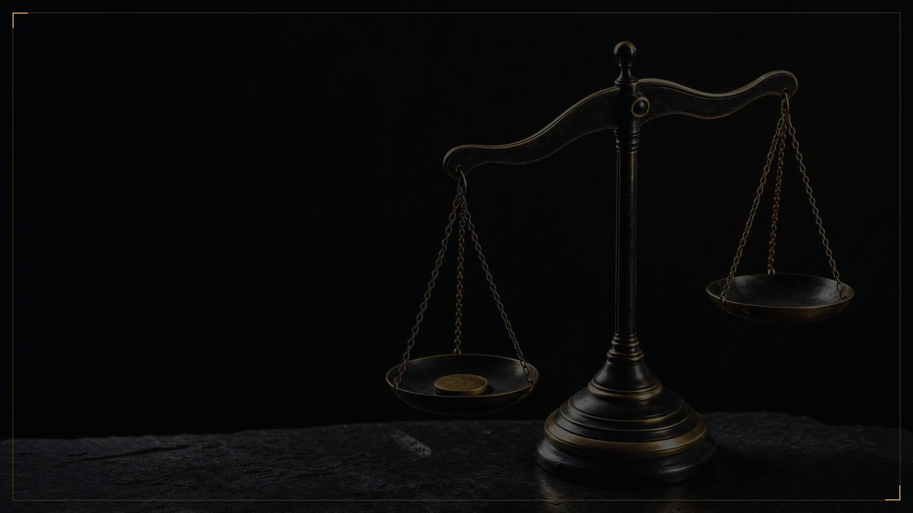
Spartan OS
08 · BONDS, A SEPARATE PRODUCT
Buy RM below market. Own conditions, own cap.
Bonds are bought from the same dashboard but are their own product. A promoter should never present them as staking.
BOND | ENTRY | WHAT YOU BUY | DAILY | CAP | EXTRAS
Liquidity bond · 180 days | From $1 | RM at 2% to 5% below market | Paid like the 180-day stake | 4× entry value | None
Liquidity bond · 360 days | From $1 | RM at 4% to 10% below market | Paid like the 360-day stake | 4.5× entry value | None
Liquidity bond · 540 days | From $1 | RM at 6% to 16% below market | Paid like the 540-day stake | 5× entry value | None
Burning bond | From $500 | 250% release, 150% net | 1.5% a day, net · no compounding | 2.5× | 20% energy · 3% GD airdrop
WORKED EXAMPLE
STAKING OR BOND
THE BURNING BOND
$1,000 into a 540-day liquidity bond at 15% off buys RM worth $1,150. At $30.46 per RM, your entry price is $26.21.
Staking releases RM faster and adds extra rewards. A bond buys more RM under the same ceiling. Ask which the person wants to hold.
How leaders buy energy for team income, and one of only two ways to obtain GD. Minimum $500, no maximum.
Discounts as stated on 7 September (2%, 4%, 6%) and 14 September 2026 (about 5%, 10%, 15% to 16%). They float with the market. Not a promise of return.
09 / 13
Notes:
Keep it short. 'Cheaper entry, same ceiling, no extras. Some people want more tokens; some want the daily number.'

Slide 10
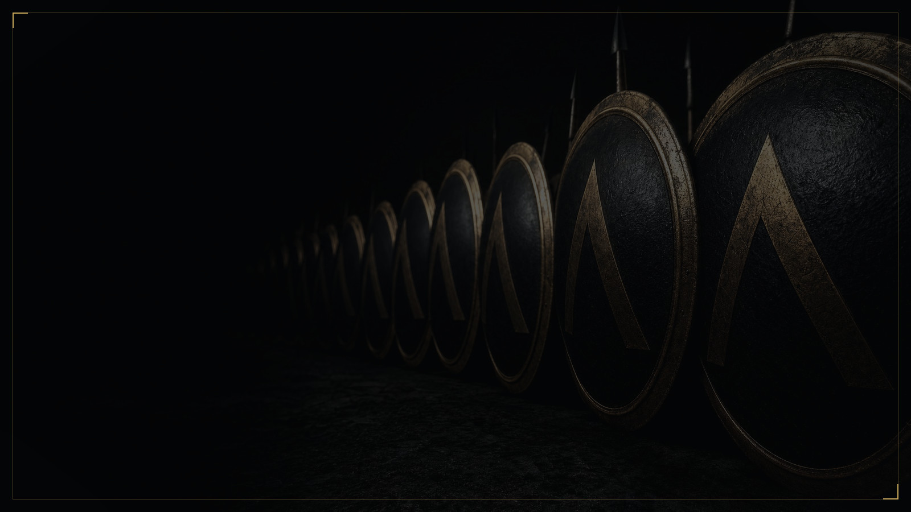
Spartan OS
09 · BUILDING A TEAM
Two legs, not three. The rank pays daily.
8% of the ROI on your first level, 4% on the second, 2% on the third, every twelve hours. Then twelve ranks paid daily from the DAO pool, with rank-differential, same-rank and override (overtaking) rewards of about 10% to 15% on top.
RANK | PERSONAL STAKE | DIRECTS ($100+) | EACH OF TWO LEGS | RANK REWARD | APPROX. DAILY, REFERENCE ONLY
V1 | $500 | 3 | $10,000 | 5–10% | $15 – $25
V2 | $1,500 | 4 | $50,000 | 8–15% | $80 – $180
V3 | $3,000 | 5 | $150,000 | 10–20% | $150 – $300
V4 | $5,000 | 6 | $300,000 | 15–25% | $300 – $500
V5 | $7,000 | 8 | $600,000 | 20–35% | $800 – $1,200
V6 | $9,000 | 10 | $1,200,000 | 25–45% | ≈ $1,800 – $3,780
V7 | $11,000 | 12 | $3,000,000 | 35–55% | ≈ $6,300 – $11,550
V8 | $13,000 | 14 | $6,000,000 | 45–65% | ≈ $16,200 – $27,300
V9 | $15,000 | 16 | $12,000,000 | 55–75% | ≈ $39,600 – $63,000
V10 | $18,000 | 18 | 2 × V9 | 65–85% | ≈ $93,600 – $142,800
V11 | $20,000 | 19 | 2 × V10 | 75–95% | ≈ $216,000 – $319,200
V12 | $50,000 | 20 | A V11 in each leg | 85–100% | ≈ $489,600 – $672,000
LEVEL INCOME, EVERY TWELVE HOURS
8 · 4 · 2% OF DOWNLINE ROI
On the ROI of your first three levels, before any rank.
TWO LEGS, TWO JOBS
The larger leg qualifies the rank; the smaller pays the reward. V1: $500 staked, three qualified directs, $10,000 in each leg.
SAME RANK, DIFFERENT PAY
AICS scores each account on holdings, activity, contribution and retention. Rewards move with smaller-leg volume, the block reward rate and that score: two V6s can be paid differently.
Approximate daily team rewards, reference only. V1–V5 as stated on 7 Sept 2026; V6–V12 supplied by Spartan OS on 16 Sept 2026 from the daily block reward rate. Actual rewards vary with smaller-leg volume, the block reward rate, AICS score and team structure. Not fixed, not guaranteed. Energy applies to level income only: 0.2 RM burned per RM, or a 360-day stake.
10 / 13
Notes:
'V1 is $500, three people and two teams of $10,000. Most of you have that in your phone already. Origin needed three teams at $50,000.' Read V1 to V5 down the last column and stop. If someone asks about V6 and above, say the words on the slide: approximate, reference only, set by the block reward rate on the day and by the AICS score. Never say guaranteed.

Slide 11
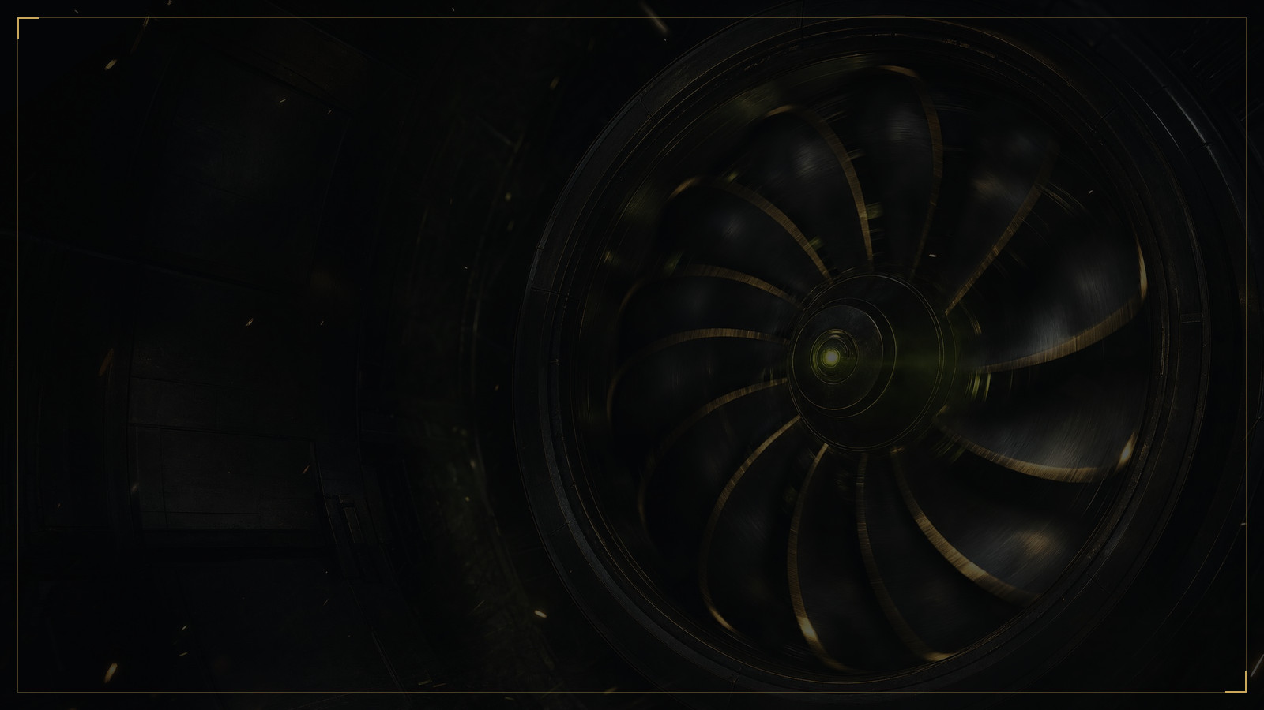

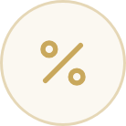

Spartan OS
10 · WHY THE PRICE HOLDS
Balance first. Price second.
O², RM's adaptive balancing protocol, is positioned by Spartan OS as a global first: Olympus DAO and Origin, upgraded so the rules adapt to the market. It balances supply and demand and protects liquidity. It does not set the price.
TURBINE
SELL TAX
BURN AND BUYBACK
INCENTIVE POOL
Buy one to one
Panic costs money
Supply goes down
Holders get paid for the dip
1 : 1
5% → 30%
65%
35%
Every RM you earn is claimed into the turbine. You buy the same amount on the DEX, wait 24 hours, and both are yours. Every payout is also a purchase.
Buying is free. Selling starts at 5%. If the price falls more than 5% against its rolling average, the tax climbs in steps to 30%. Slow selling is cheap; dumping is not. The aim is to slow cascades, not to block exits.
1.2% of every sale buys back RM and GD and burns them. Of any extra tax, 65% is burned outright.
The other 35% of extra tax goes to anyone with $200 or more in a 360 or 540-day position. When others panic, you are paid.
WAIT
RATIO
BUY TAX
REASSESSED
OF EVERY SALE
OF EXTRA TAX
MINIMUM
OF EXTRA TAX
24 hours
One to one
0%
Every three hours
1.2%
65% burned
$200 in 360 or 540
35% shared
As stated by Spartan OS in the 14 September 2026 briefing and the O² core interpretation deck. O² reads TWAP, trade price, buy and sell volume and liquidity depth every three hours; price is a signal, not the verdict. It can defend liquidity and slow concentrated selling; it cannot manufacture demand. The market decides the price.
11 / 13
Notes:
This slide answers the question they are thinking: 'what stops it collapsing like the others.' Answer it before they ask, and answer it their way: the protocol protects liquidity and slows a cascade; it does not promise a price. Then the four cards, one breath each: turbine, tax, burn, pool.

Slide 12




Spartan OS
ANUBIS
11 · WHY NOW
Ninety days old. Not ninety days late.
The first project on a new chain from a foundation with a record. The positions that matter are the ones taken before the second and third applications arrive.
FIRST
FAIRER
CHECKABLE
First project on the chain
Built for leaders who work
Nothing to take on trust
Anubis Chain has one consumer application today. The roadmap names a second and a third. Leaders who build now inherit every user those applications bring.
Two teams, not three. Caps that other Olympus-style systems never had. Principal back daily. A score that pays the active leader more than the passive one.
chainlist.org/chain/6714, browser.anubispace.org, The Graph, Blockscout, the DEX pool. Every figure in this deck can be checked tonight, by anyone.
MAINNET
APPLICATIONS
TEAMS
PRINCIPAL
CHAIN ID
EXPLORER
April 2026
One live, two named
Two, not three
Back daily
6714
browser.anubispace.org
Roadmap items as published; dates for the second and third application are the project's to confirm.
12 / 13
Notes:
Do not oversell scarcity. State it once: 'The second application is coming. The people who built their team under the first one are the people it lands on.'

Slide 13









Spartan OS
ANUBIS
12 · THIS WEEK
Add. Bridge. Bond.
Seven steps, one evening. The bond comes first; staking comes once you are in and hold RM bought from your leader. The links below open on click and scan from a phone.
1
Install Bitget Wallet, write the seed phrase on paper, switch to Anubis Chain (chain ID 6714); other wallets add it by hand
2
Bridge five dollars of DAI from BNB Chain, the bridge address typed and never taken from a chat: it arrives as gasDAI, the fuel for every move
3
Buy USDT on an exchange, withdraw to BNB Chain, bridge it to Anubis through app.anubisbridge.com or GaleBridge, a small amount first
4
Join through your leader's referral link or code; the referrer binds on the first connection, so never from a public chat
5
Buy the 540-day liquidity bond with USDT: RM below market, released daily, cap 5× in USDT fixed at entry
6
Claim every twelve hours through the turbine; import RM and GD. Staking comes later, with RM bought from your leader
7
Set your two teams and book your first call. Send them this deck
Anubis Chain
Spartan OS
Anubis Chain
Anubis Bridge
Explorer
Official site
Official account on X
Official account on X
Move USDT or DAI onto the chain
Every figure, checkable
anubischain.ai ↗
x.com/Spartan_Arena_ ↗
x.com/ANUBISCHAIN_ ↗
app.anubisbridge.com ↗
browser.anubispace.org ↗
Keep your seed phrase offline. No official account will ever ask for it. Links open on click; the codes scan from a phone.
13 / 13
Notes:
End with the seven steps and stop talking. Say the order once: wallet, chain, gasDAI, USDT, the leader's link, the 540-day bond, the claim. Staking is not tonight's step; it comes once they are in and hold RM bought from their leader. Leave the links on screen: they can scan the codes while you take the first question. Do not fill the silence.

